Slide 1


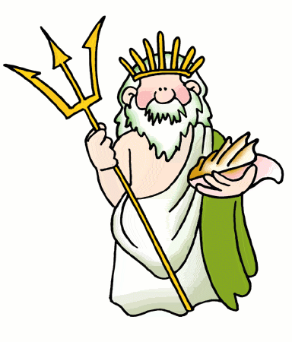
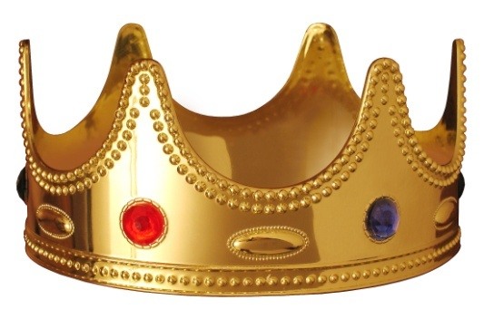
Mapping Activity
The West and the World

Slide 2
Discussion
Why are maps important?
What do they provide us?

Slide 3
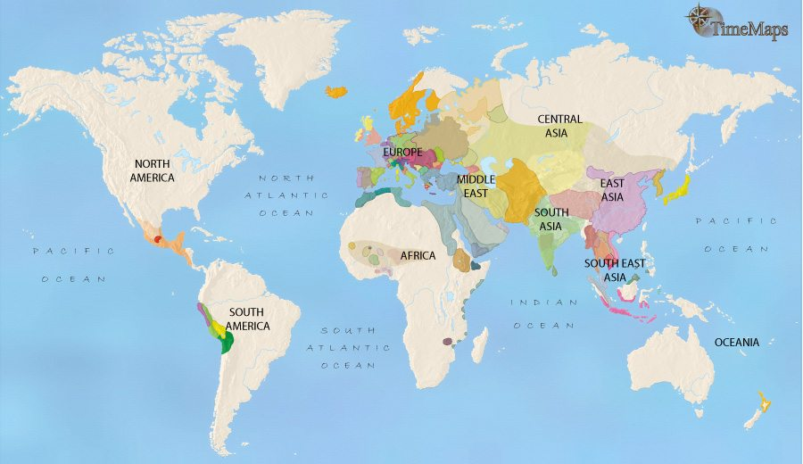
World Map 1453

Slide 4
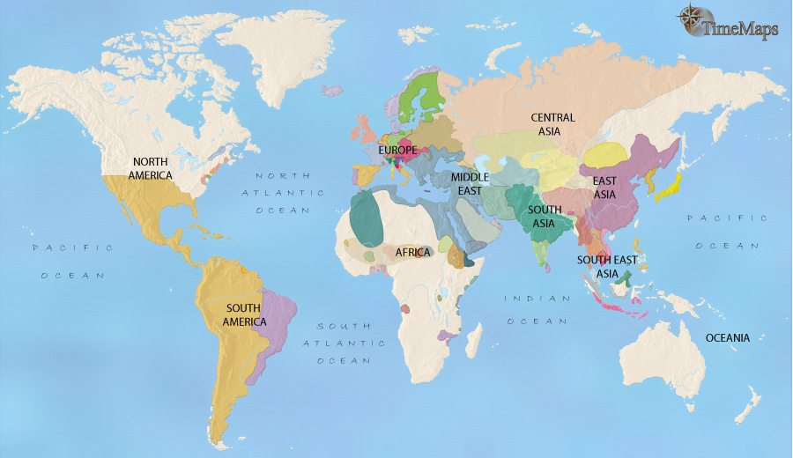
World Map 1648

Slide 5
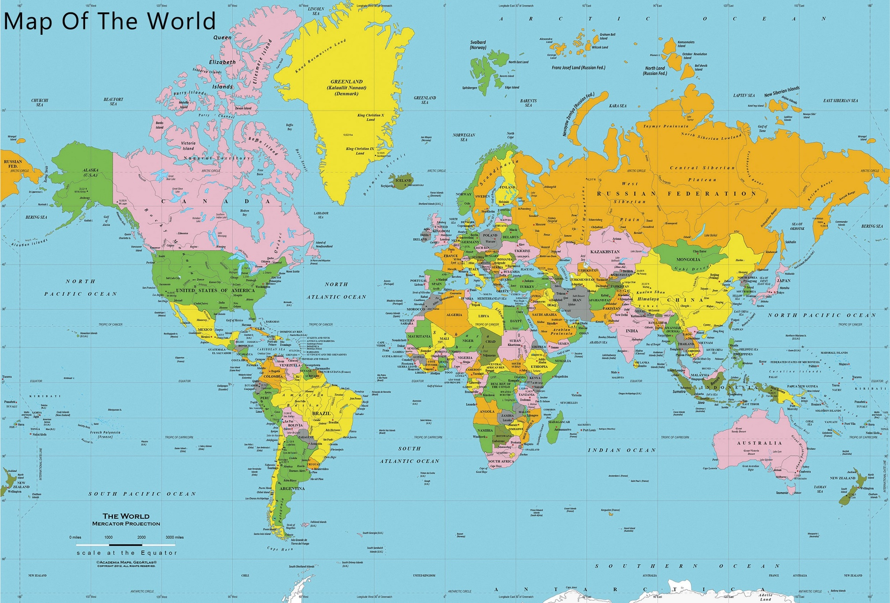

Slide 6
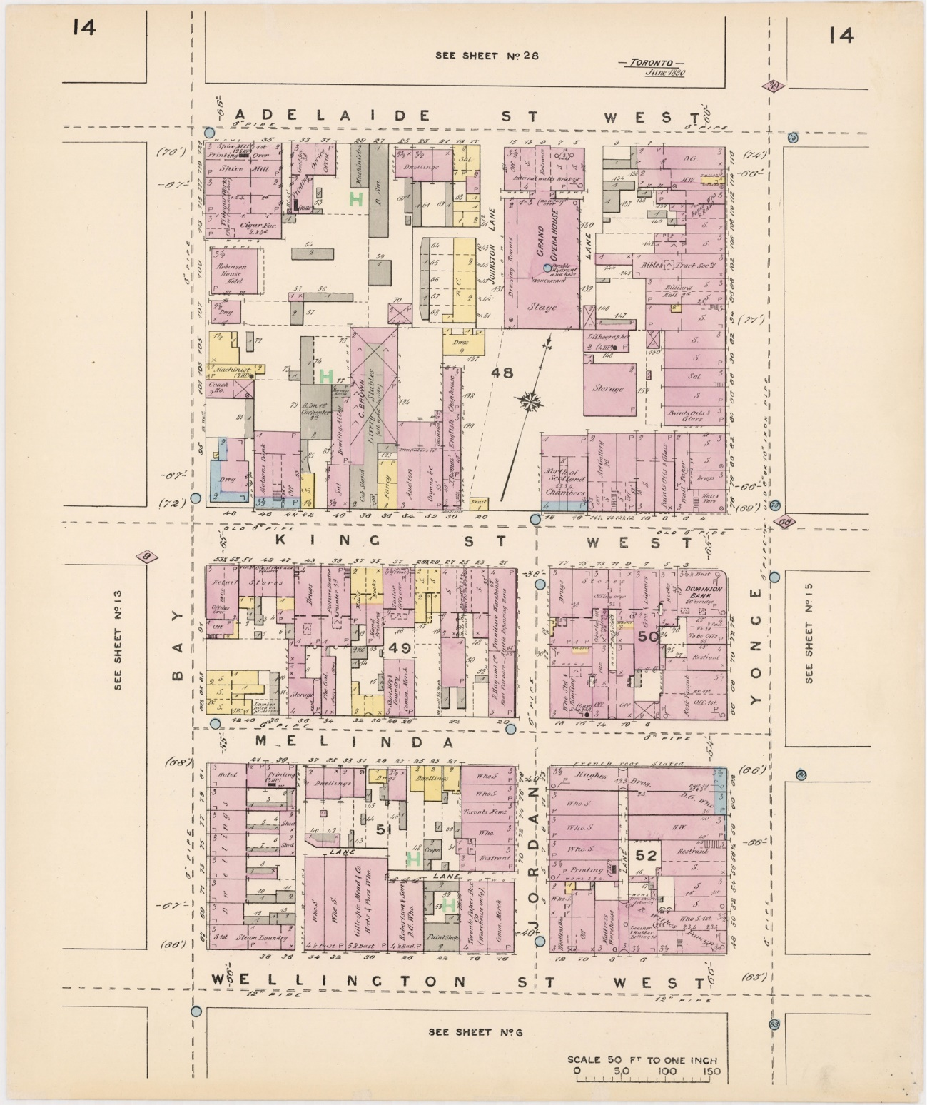
This is downtown Toronto in 1880.
King and Jordan

Slide 7
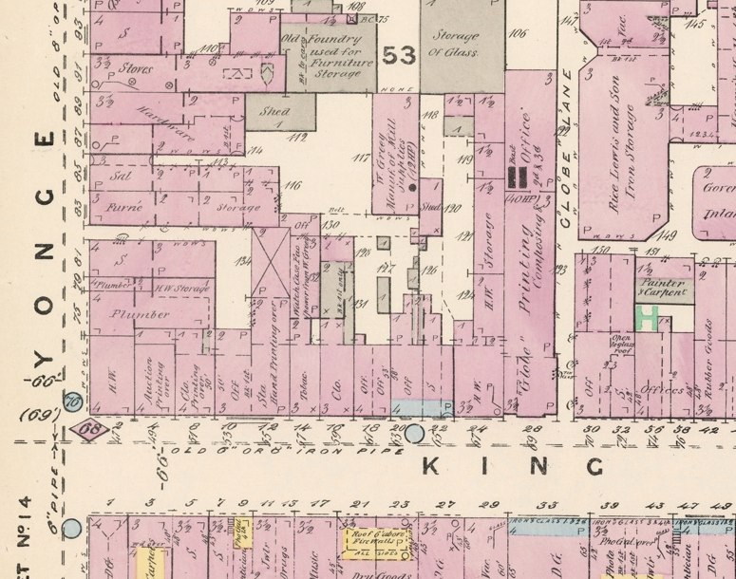

Slide 8
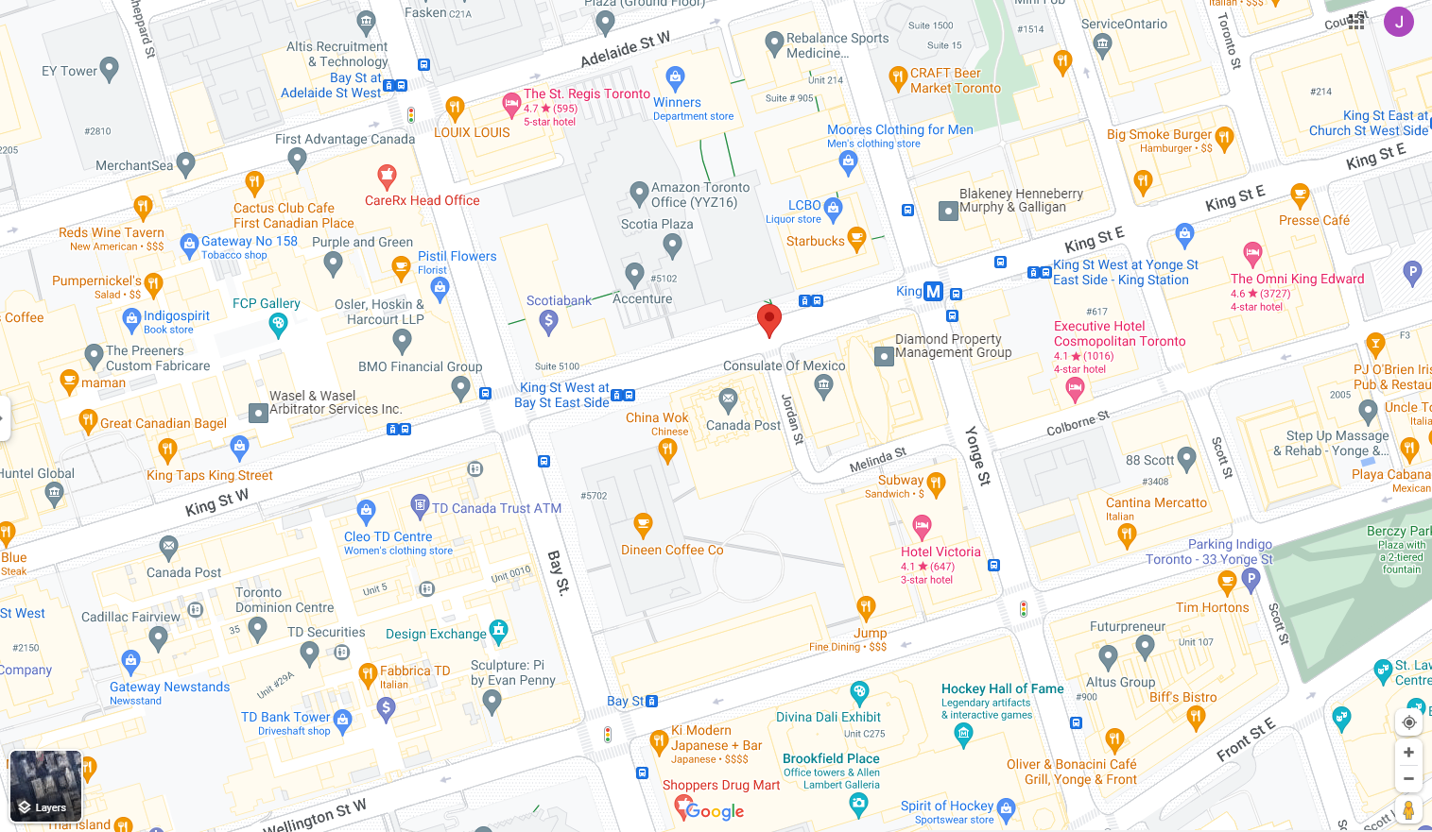

Slide 9
Helpful Websites
World Maps 1450-1650 CE
https://www.timemaps.com/history/world-1648ad/
https://www.scribblemaps.com/maps/view/World_Map_1450-1750/PnsKp_K7z2
http://geacron.com/home-en/
https://www.google.com/maps/place/Washington,+DC,+USA/@38.8935128,-77.1546602,11z/data=!3m1!4b1!4m5!3m4!1s0x89b7c6de5af6e45b:0xc2524522d4885d2a!8m2!3d38.9071923!4d-77.0368707
History of Western Culture 1450-1650 CE
https://www.khanacademy.org/humanities/ap-art-history/cultures-religions-ap-arthistory/a/a-brief-history-of-western-culture
https://www.timemaps.com/civilizations/western-civilization/
3. History of Europe 1450-1650 CE
https://www.britannica.com/topic/history-of-Europe/The-emergence-of-modern-Europe-1500-1648

Slide 10
Mapping Activity
Forum Post
Student Activity: In your groups, locate 2 world maps from 1450-1650 that show different civilizations and cultures. Remember to provide the link(s) to the maps when you post your answers to the below questions.
Answer the following about the maps:
What areas do these maps represent?
What is their presence in the world?
How are your maps similar/different to the same area today?
Explain your findings:
4. What new knowledge do you have?
5. What surprised you?

